Slide 1
Overview on
Situation of Human Trafficking
in Lao PDR

Slide 2
Presentation Contents
Situation of Human Trafficking in Laos
Policy Framework
Coordination mechanisms

Slide 3
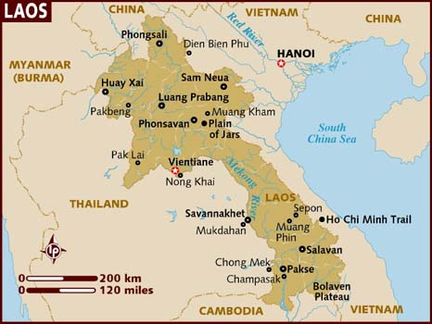
1. Lao PDR profile

Slide 4
Situation of HT in Laos
Lao PDR is a country of origin and transit for victims of human trafficking. Much of the trafficking from Lao PDR takes place within the context of large, seasonal labour migration to Thailand. This migration is grounded in a long history of cross-border movement and cultural similarities. Tens of thousands of young people migrate to Thailand on a seasonal basis.

Slide 5
Situation of HT in Laos
Despite similarities in language and culture, the irregular nature of this migration, and the lack of protection for migrant workers in many sectors, contributes to making young Lao people vulnerable to exploitation and abuse. Many young people start their journey as voluntary migrants, only to be tricked, cheated or forced into trafficking situations. Recognising that at least some of the willing supply of labour in Lao PDR is matched to demand for labour in Thailand, increased migrants during the past 10 years , the Government recognises that new approaches are required to address migration and trafficking issues.

Slide 6
Type of working in Thailand
- Men and boys provide the principal labor for
fishing,
prawn-farming,
poultry farming
pig farming,

Slide 7
Type of working in Thailand (cont.)
- Women and girls provide labor needed in
garment factories
domestic workers.

Slide 8
Type of working in Thailand (cont.)
Most child laborers migrate to urban
areas, where they work in
factories
construction sites
urban households
restaurants
entertainment centers,
farms.

Slide 9
Trends in Trafficking
All most haft of female migrants traveled to Thailand with brokers,
Some falling into debt to pay for the travel costs.
56% of the female migrants ended up working most frequently in domestic labor and 21% in the entertainment sector , these two risky occupations that leave women and girls open to various forms of exploitation.
As to their experiences, the female migrants suffered many abuses:
24% being cheated out of their wages
40% being locked up
13% being sexually abused.

Slide 10
Policy Framework
- Anti-human trafficking issue is in the National Plan, the strategy No 11 project workplan 111.
- Criminal law article 134 mentioned on punishment the traffickers;
- In 2005 regulated law on development and protection of women and
children;

Slide 11
Policy Framework
- In 2006 regulated law on the rights and interests
of children;
- in 2006 adjusted lalour low
- in 2007 Established National Plan of Action Against
Commercial Sexual Exploitation of Children
- In 2008 Drafted on Against Trafficking Plan

Slide 12
Policy Framework
- In 2002 signed MOU with Thailand on employment
- In 2004 signed MOU with GMS countries (COMMIT)
on Against Trafficking.
- In 2005 signed MOU with Thailand on Against trafficking
in person, especially women and children.
- Adopted ASEAN statements on protection of right of
labour migration and their families.
- In 2010 signed MOU with Vietnam on Against Trafficking
in person.

Slide 13
Ratified Conventions
In 1981 become the member of convention on
eliminate to women;
-in 1991 become the member of CRC convention
-In 2003 ratified convention on Inter Anti-Criminal of UN and sub-agreement on against and punish the traffickers.
-In 2005 ratified ILO convention No 138 concerning Minimum Age for Admission to Employment and No 182 concerning the Prohibition and Immediate Action for the Elimination of the Worst Forms of Child Labour

Slide 14
Coordination mechanisms
In 2004, Laos had established National Committee against Human Trafficking, chaired by Deputy-Prime Minister and also established a unit on anti-human trafficking in provinces under the public security department.
Attended the SOM meeting for exchanging and sharing the lesson learns on implementing of COMMIT, and National Plan.
Attend and host the Lao-Thai meetings on against human trafficking for exchange and sharing the ideas on anti-human trafficking along the borders.
Conducted International Against Human trafficking in every year of date 12 December.

Slide 15
Without strengthening regional cooperation, a single country alone could not resolve this problem

Slide 16
Thank you

