Slide 1
Country Presentation on Case Management
By
Mr. Aung Kyaw Moe
Deputy Director, MOFA
Mr. Kyaw Win
Assistant Director, DSW
Mr. Thein Win
Assistant Director, MOL
Ms. Mya Mya Thet
Senior Staff Officer, MOL

Slide 2
Structure
Trafficking in Person Law was promulgated on 13rd September, 2005.
According to TIP Law, Central Body for Suppression of Trafficking in Person (CBTIP) was formed in 2006.

Slide 3
Central Body for Suppression of Trafficking in Persons
(CBTIP)
Three Working Group
Prevention
&
Protection
Repatriation,
Reintegration
&
Rehabilitation
Legal Framework
The Deputy Minister for Home Affairs as the chairman
The Deputy Minister for the M.S.R.R as the chairman
The Deputy Attorney General as the chairman

Slide 4
Working Group on Repatriation, Reintegration & Rehabilitation
M.S.R.R (Coordination)
D.S.W (Cooperation & Direct Assistance)
Government’s
Other Departments
D.S.W
field Office
UN
INGOs
NGOs

Slide 5
Governmental Organizations
M.O.H.A
M.O.F.A
Department of Immigration & National Registration
General Administration Department
D.O.H
Department of Religious Affairs
M.O.E

Slide 6
UN & INGOs & NGOs
Myanmar Women’s Affairs Federation (MWAF)
UNIAP
UNICEF
IOM
World Vision (Myanmar)
Save the children (Myanmar)

Slide 7
Services
Pre Return Services
Repatriation Services
Rehabilitation Services
Follow-up Services

Slide 8
Pre-return Services
Discussing with BATWC (Bureau of Anti-trafficking on women and children) from Thailand at the case management meeting
Dispatching the staff from D.S.W to Thailand to work directly with victim to collect the victim’s address and personal data in order to repatriate quickly

Slide 9
Repatriation services
Informing the Immigration and National Registration Department for Nationality Confirmation of Victims.
Family Tracing/ Assessment
After confirming Myanmar nationality, discuss and set the Date, Time and Place between the two sides for repatriation.
Transferring the victim at the designated place accompanied with local authority, D.S.W, UNIAP, MWAF and other related organization.

Slide 10
Rehabilitation Services
Taking care of them for two weeks at D.S.W shelter to provide knowledge and skills by respective organization including.
Briefing about trafficking in person by Anti-trafficking Taskforce.
Counseling / problem solving by DSW
Briefing about Myanmar traditional culture by MWAF
Vocational Training by D.S.W
Briefing about Immigration Law & Registration by Department of Immigration & Registration

Slide 11
To be continued
Briefing on the Labour Law by the Department of Labour
Medical Check-up and HIV Testing by the consent of victim by the Department of Health
While the victim received care of the shelter, D.S.W staff and concerned Agency confirmed address and tried to contact their family.

Slide 12
Reintegration services
After two weeks-stay in D.S.W shelter, victims were repatriated to their family with the collaboration of D.S.W, MWAF, INGOs & NGOs.
Victims were provided some financial support and material by MWAF & Local authority and arrange job opportunity.

Slide 13
Challenges
Family migration
Vocational Training for 14 days is not sufficient.
Follow-up visit can’t provide regularly because of very geographical distance.
Sometimes, Parent/ relatives are not willing to receive victims back.

Slide 14
Thank you !

Slide 15
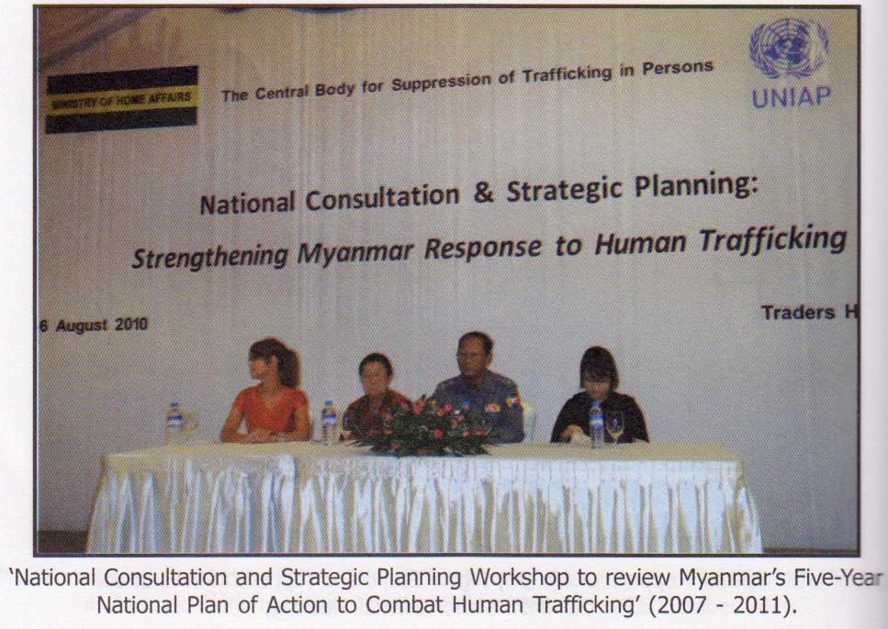

Slide 16
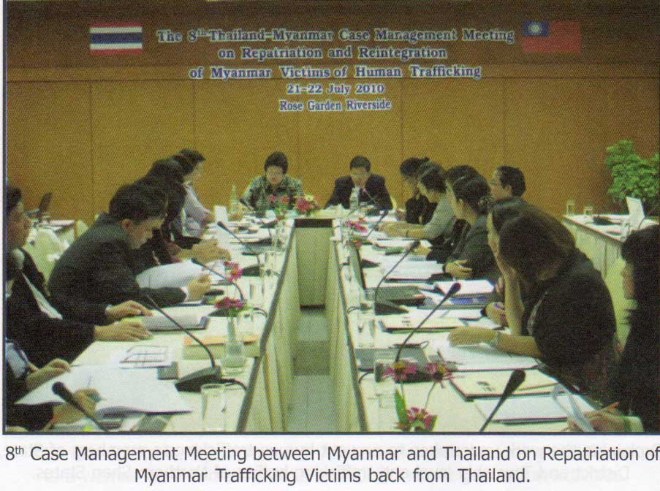

Slide 17
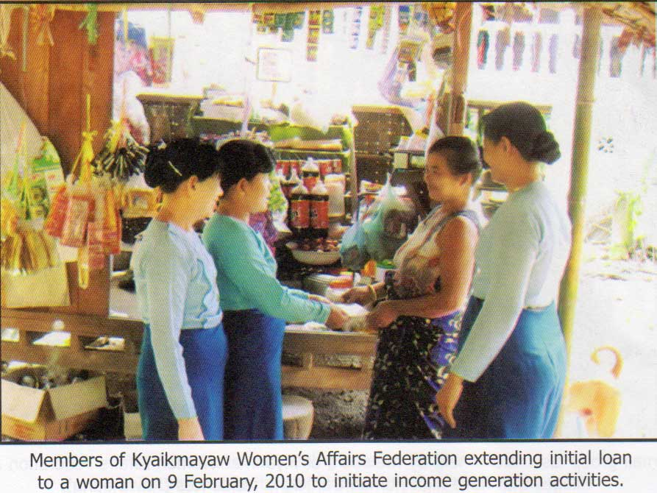

Slide 18
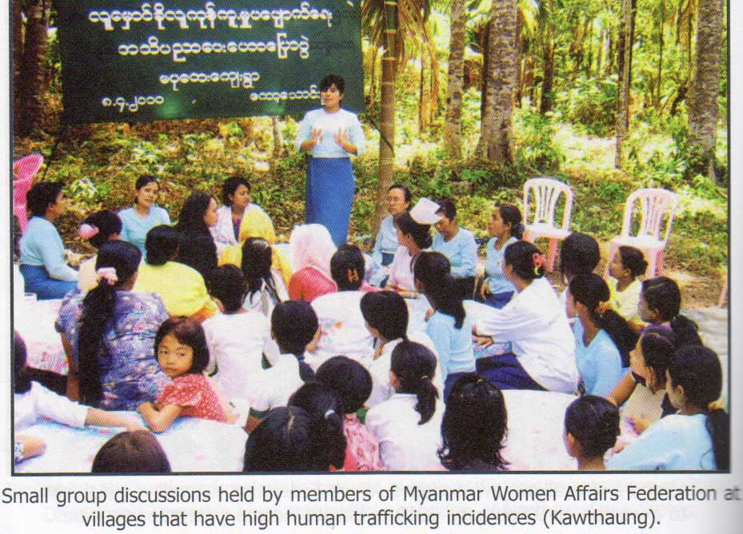

Slide 19
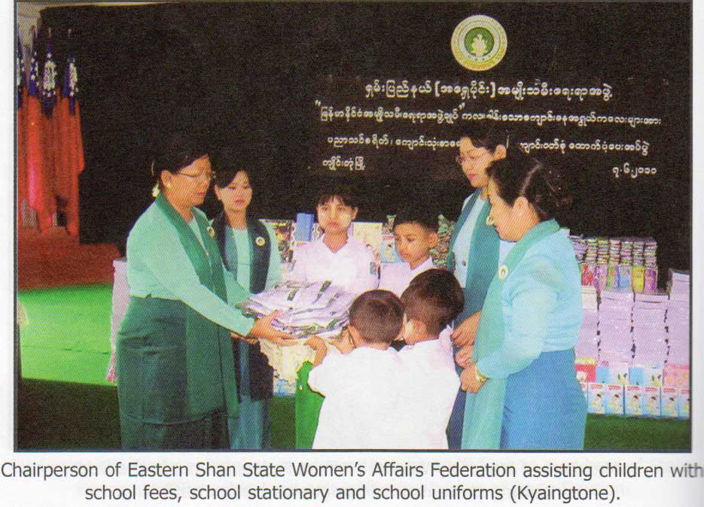

Slide 20
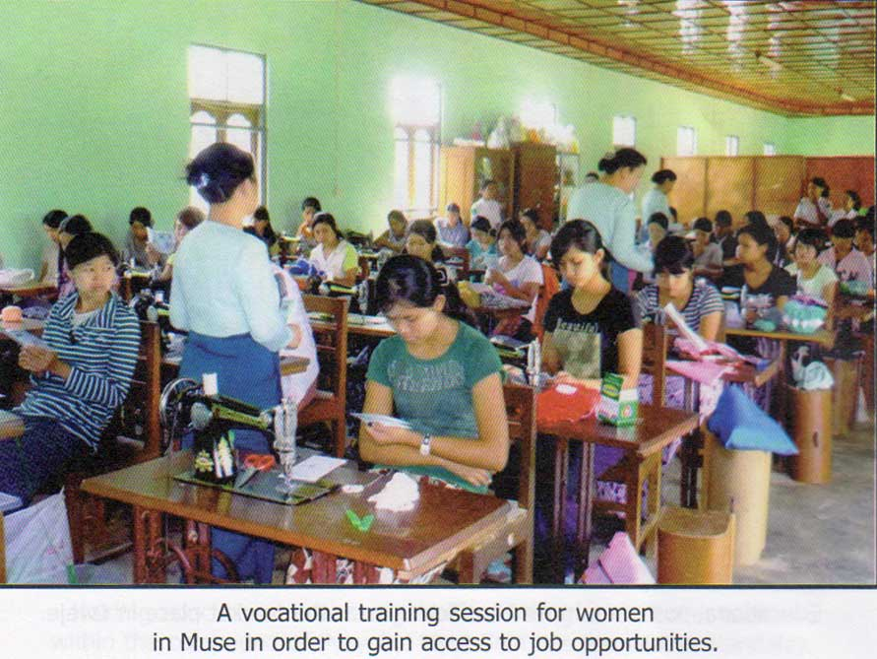

Slide 21
