Slide 1
Case Management Myanmar

Slide 2
Objective of case Management
To protect Myanmar victims of trafficking by giving practical effect
To provide psychosocial support and Counseling
To know victims address and repatriate to their home safely

Slide 3
Identified Victims within 2007-2012
No. Year Repatriated Victims
2007 93
2008 232
2009 431
2010 348
2011 219
2012 136

Slide 4
Case Worker Visit
Case Worker Visit conducted before Case Management Meeting
The quarterly basis
The two Case Workers visited to the Shelters
The findings from the Case Worker Visit input to the Case Management Meeting

Slide 5
Cooperation on Special Needs Cases
Victims intentionally or unintentionally provides inaccurate information
A victim is too young
A child victim has only traceable family members in Thailand
A child victim has traceable family members in both Myanmar and in Thailand

Slide 6
Cooperation on Special Needs Cases (Contd.)
Severely traumatized persons or psychological problems
Serious medical/health problems
Substance/drug abuse problems
Physical disabilities
Past experience of violence
Have dependent children or family members
Participating in legal proceedings in Thailand
Security problems upon returning home to Myanmar
Socially marginalized

Slide 7
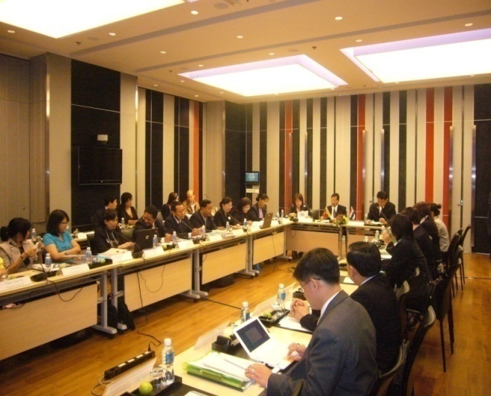
Bilateral Meetings
Cooperation on Bilateral Case Management Meetings
Cooperation on Bilateral Case Worker Visits Quarterly basis

Slide 8
Special Cases
M09-PK014 Moe Aye
Age 9 years
Parents U Win Soe (Father) Daw San San Maw (Mother)
Address No.(81), Sanpya ward, Zarthapyin Village, Phan Township
Parents are working in Thailand. Parents left him at Monastery. The monk sent to shelter. He can’t tell his family situation clearly. Can’t get NC and Family tracing in Myanmar. He was already repatriated. Now he lives with his mother-in-law.

Slide 9
Special Cases
MO6 - PK 176 Yan Naung Soe
Age 15 years
Parents Daw Macho (Mother)
Address Kaw Thoung
He has arrived the shelter since 2006. He can mention that his parents are working in Thailand and can’t tell his family address and parents’ name. He can speak in Myanmar. Now he is in Yangon boys training school.

Slide 10
Special Cases
M11- PK 003 Than Zaw Htwe
Age 9 years
Parents U Awin (a) Wa Tot (F),Daw Mee Nge
Address Nyaung Ma Kwin Village, Mon State.
He came to Thailand with his brother. His brother was arrested by police and sent to IDC. He can’t tell his family situation clearly.
He is attending school in Yangon.

Slide 11
Regular Monitoring & Evaluation of SOPs
Regular Monitoring & Evaluation of the Implementation of Myanmar- Thai Bilateral SOP
Form M & E Group consist of four members by both side
M & E Group meeting will be take place back to back of CMM meeting
Outcome of M & E meeting will be presented during CMM meeting
Cooperation on Case Management and the Repatriation and Reintegration of Victims of Trafficking

Slide 12
Achievements
Share Myanmar Immigration rules & regulations
Conduct Repatriation Program timely & speedy manner.
Explore the special need cases, to find out solution for those cases.
Victim's information exchange regularly

Slide 13
Achievements
Overcome the language barrier between Myanmar victims & Thai Shelter staffs.
Have chance to strengthen relationship between Myanmar Department of Social Welfare & Thailand Department of Social Development and Welfare.

Slide 14
Kindly Give Your Guidance

