Slide 1
Presentation on
Processing of return and reintegration
Lao PDR

Slide 2
Presentation Contents
Processing of return and reintegration
Lessons learned and Challenges

Slide 3
Number of retrunee by province (2001-2012)
No | Province | Total
1 | savannaket | 675
2 | Khammoun | 72
3 | Bolikhamsay | 44
4 | Champasack | 298
5 | Salavanh | 257
6 | Attapeu | 11
7 | Vientiane | 128
8 | Vientiane Capital | 251
9 | Xayyabouly | 48
10 | Luangprabang | 39
11 | Luangnamtha | 6
12 | Bokeo | 24
13 | Xiengkhuang | 11
14 | Oudomsay | 3
15 | Phonsaly | 1
16 | Huaphanh | 6
17 | sekong | 3
 |  | Grand total 1877

Slide 4
Return and Reintegration Process
Thailand
Laos
Case interview and documentation
Send request for family tracing and assessment
Receive request for family tracing.
forward the information to the provinces, where family tracing and assessment will be conducted
follow up with the provinces on family tracing/assessment
Perform family assessment
Receive results.
Coordinate return
Send results of family tracing/assessment to host country
community and family preparation
Prepare and plan for return
- Coordinate with partner agencies
- Admin., financial and logistics
arrangements
Prepare the returning person
Repatriation
Meet returnee at Friendship Bridge
Vientiane Transit Center
- Interview by ATD
- HIV/AIDS test
- Service available for returnees
- Psychosocial recovery activities
Escort to provinces of returnees
Coordinate with provincial level on return
Follow-up
Reintegration assistance
Feedback to partner agencies in former host country.
Follow-up & feedback to agency and former host country.
Receive feedback from home country in order to inform on good practices.

Slide 5
Lessons learned Challenges
Can not stop labor migration, because of Laos shared border with Thailand, similar language, traditional and the different of development and trendy.
Local staff are not skill about caring of returnee,
After sending the returnee to home, if we do not follow or assist them..they might be victims again.

Slide 6
The processing of return and reintegration
3. Return and Reintegration Process
‘’ provincial level ‘’
Social Welfare department will coordinate with PLSW to inform date of sending the victims, number and special case, the returnee travel by bus with staff of social welfare department and discuss with PLSW for sending them back their family.

Slide 7
The processing of return and reintegration
Cross-cutting process
‘’Keeping and sending information of returnee’’
Bilateral data sending: DSWD of Thailand will prepare the data of
returnee and send to SWD of Laos.
Internal data: All the data of returnee will be saved in secret by
SWD of Laos.
Pre-return process
‘’searching and Family assessment”
data of searching and family assessment will be delivered by DSW
of Thailand to SWD of Laos such as: Name of Victim, number of family members, address and other needed data for starting to search and assess their families.

Slide 8
Process of return and reintegration
Pre-return process
‘Return Coordination Meeting’’’’
this meeting will be conducted among related sectors : social
welfare department, Anti-trafficking Department, Counseling
Center, AFESIP, VFI and IOM.
Return process
‘’ Activities in Shelter’’
All activities conduct in shelter reference to book “Nearly
home’’, ‘’ Health checking‘’
the shelter will provide ,counselling and health checking include HIV, AIDS and STI.

Slide 9
Process of return and reintegration
health and nutrition’
shelter will provide three meals/day and snack.
interview
interview 2 parts: Anti-Trafficking Department will search
the data of broker and traffickers, and the victims will
be interviewed by social workers.
Psycho-social Activities
The schedule of activities is rearranged depending on the
availabilities of related organizations

Slide 10
Coordination Mechanism
Based on MOU Lao -Thai on Against Human
Trafficking Since 2007 Lao-Thai have conducted a regular Cases Management Meeting ( CMM ), has implemented 12 meetings
Purpose of the CMM are :
Cooperation in the suppression of human trafficker,
Preventive measure
Repatriation

Slide 11
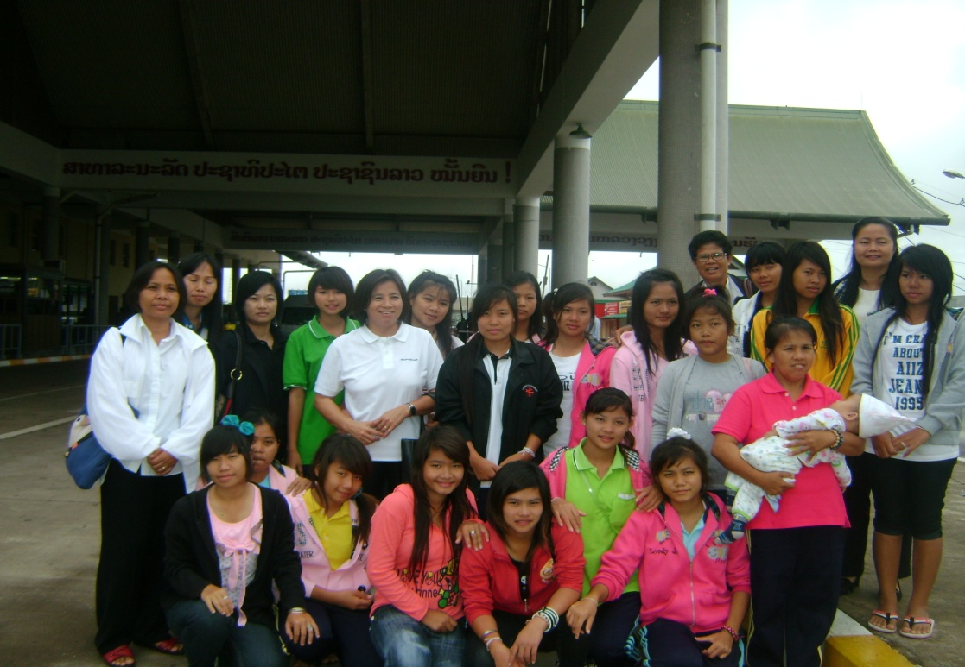
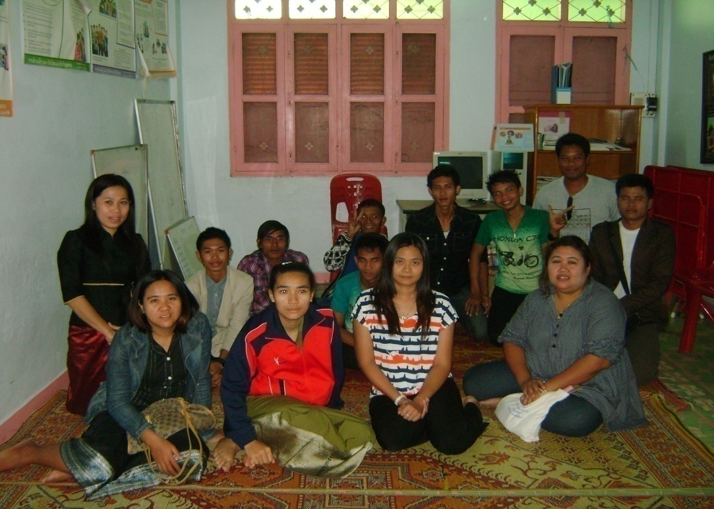
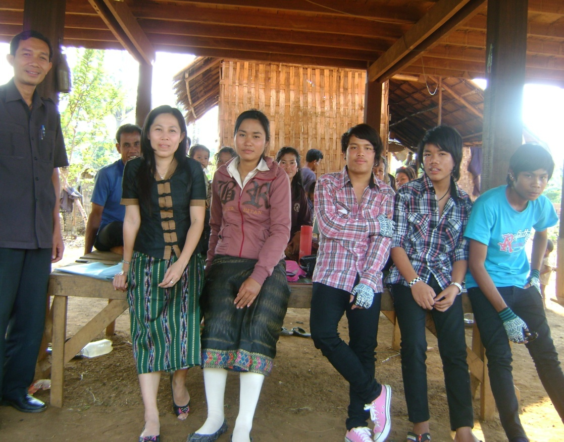
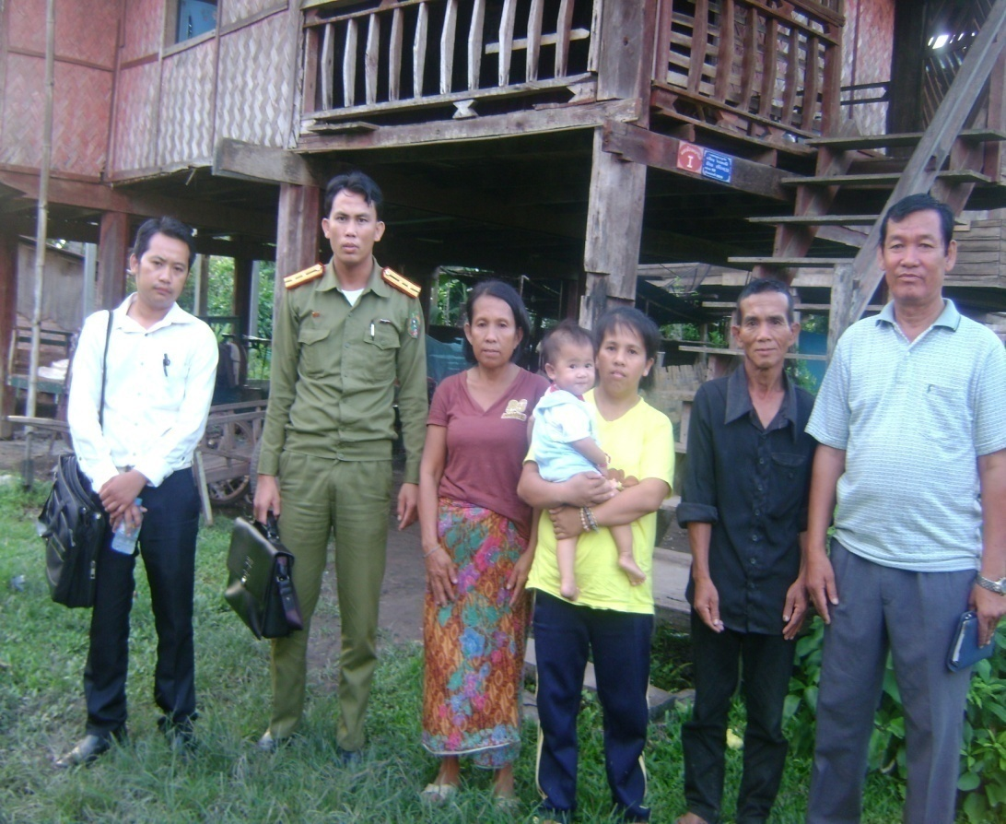
Repratriation and reintergration

Slide 12
Collaboration between central level and Local level
Local level
National secretary of committee for Anti-trafficking
Ministry Foreign Affaires
Ministry of Health
Ministry of Education
Ministry of Public Security
Lao Woman Union
People Supreme Court
People public prosecute
Ministry of Justice
Ministry of Labour and Social Welfare
NGOs

Slide 13
Lessons learned
Conduct the job creation assessment needs and
provide vocational training
Awareness raising in the national wide on Danger
Illegally Working in Abroad
Improving the process of recruitment employment
Registration in the destination countries is not alternative way to stop the illegal migration

Slide 14
Thank you

