Slide 1
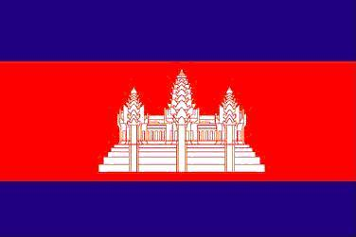
CAPACITY BUILDING WORKSHOP ON THE RETURN, REPATRIATION AND REINTEGRATION OF TRAFFICKED PERSONS IN CAMBODIA, LAO PDR, MYANMAR AND VIETNAM Lesson Learnt from field Trips in Phayao Province, Thailand (August 19-21, 2011)
By POL. BRIG. GEN. CHIV PHALLY (MoI)
POL. MAJ. LAO LIN (MoI)
MR. OUK RAVUTH (MoLV)
MR. ATH SOPISAL (MoLV)

Slide 2
A)-In Phayao University
We learnt from provincial police concerning of
trafficking in persons:
1-Prevention:
public raising awareness and educating local
people
2-Suppression:
suspects arrest and prosecution
intelligence collection from public, victims and
authorities concerned

Slide 3
3-Challenges:
difficulties in identification of victims
high tactics of brokers and bad guys
local people have low education and lack of
knowledge/information
4-Mechanism:
provincial, district and local committee to
fight against TIP

Slide 4
B)- Y.M.C.A. Center
Center standardized
-living building
-training and workshop building
-dining building
Goal of the center
-collecting poor , homeless and vulnerable
children
-providing them education
-providing shelter for victims of TIP Cases,
drugs addicted, domestic violence …..

Slide 5
-raising self-reliance
-vocational training: raising mushroom, pigs,
agriculture, vegetables, products selling and
get benefit
-community working
promoting awareness
hotline services
community reintegration
community network by ex-children

Slide 6
C)- Dok Kham Tai
Goal:
-providing safeguard to their community
-raising awareness to local people especially
children and women
-radio and TV program for community
-set up community network

Slide 7
-initiatives saving accounts for community
(banking account)
-providing consultation to community people.
-providing consultation to retired people for
self-support
-providing shelter for victims of TIP Cases,
drugs addicted, domestic violence …..

Slide 8
Recommendations:
International cooperation need
Sharing and exchanging information
Memorandum of Understanding (MoU)
International Hotline services

Slide 9
Thank you !

